Slide 1

PwC Challenge 2020
Team: CaseChasers
Vedant Athavale
Ayushi Ghelani
Ishika Chaudhari
Nikhil Jain

Slide 2
EXECUTIVE SUMMARY
Problem
Strategies a plan for Cure& Pharma Inc to launch their new COVID-19 vaccine program across the globe with profitable manufacturing and supply chain solutions.
Solution
The use of existing manufacturing, fill-finish and distribution capabilities of strategically chosen countries to support an efficient roll-out of vaccines against COVID-19.Use third party manufacturing and distribution capabilities effectively.
Benefits
Investment in the future possibility of expansion in the global market and establishing a brand. Maximisation of this golden opportunity after extensive research.

Slide 3
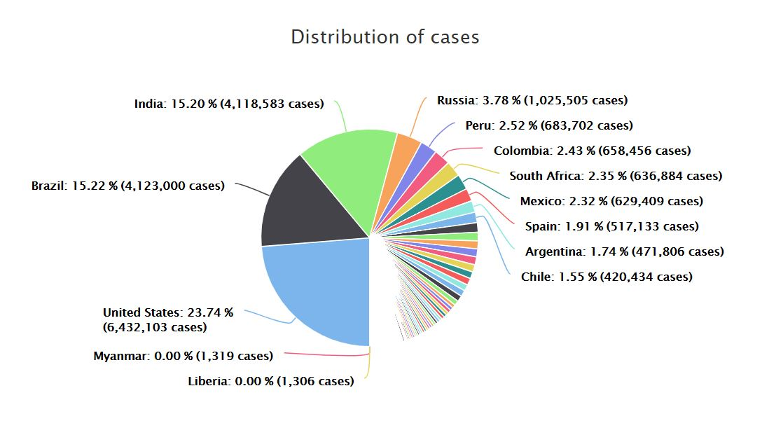
Analysis of COVID affected areas
After the USA, India and Brazil are the most affected countries. Establishing business, locally manufacturing the vaccine and using extensive transport system, the company profits will reach record high if priced smartly, for which India and Latin America are the best markets, since large possibilities of rural infection still exist.
Urgency and large demand in these countries make them vital in geographic strategy and cost optimisation.

Slide 4
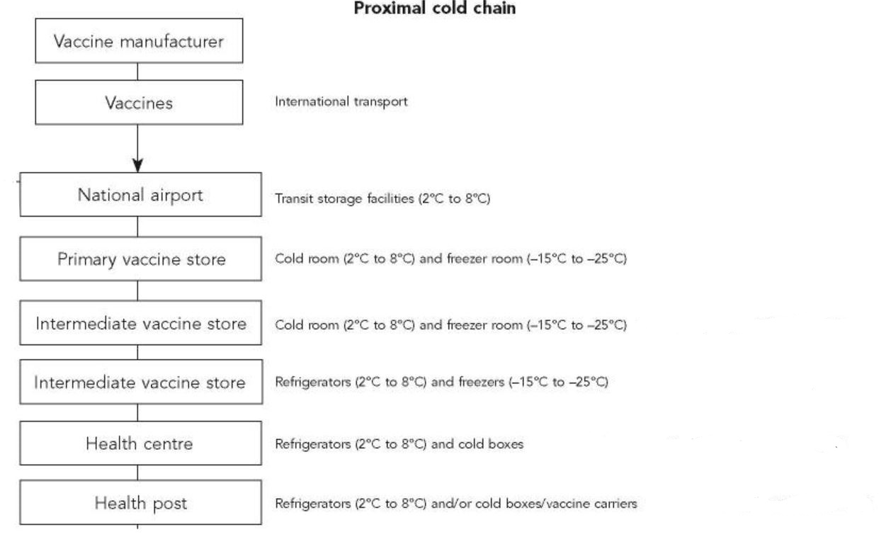
PROXIMAL COLD CHAIN
Highlights the requirements of the vaccine delivery supply chain.
Could be optimised greatly by making full use of third party manufacturers and their supply chain/ external logistics teams.

Slide 5
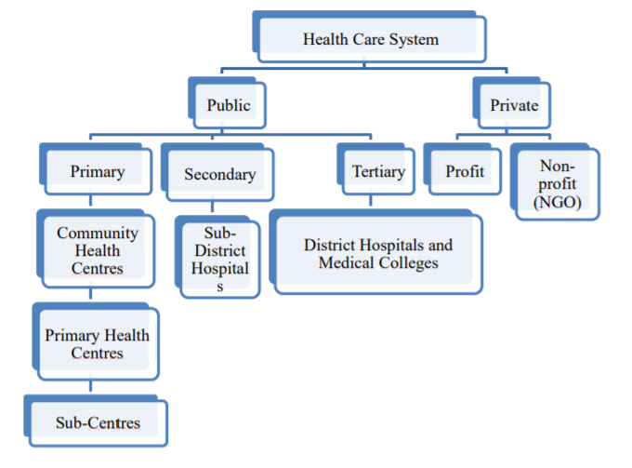
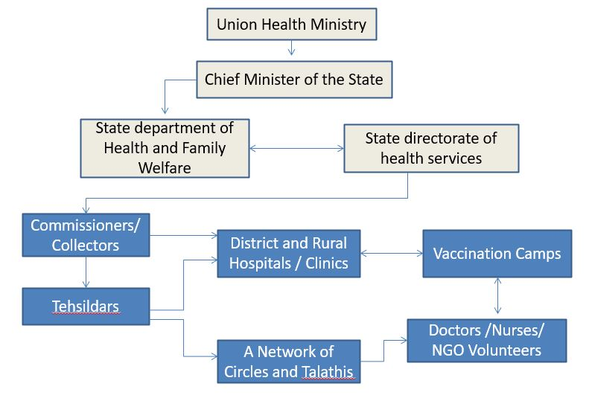
Distribution System Hierarchy
The following could be inculcated in the supply chain.
Since at the time of national emergencies such as this pandemic, governments often encourage cooperation in order to maximize the spread of the cure(in this case the vaccine.
Health care system Hierarchy
Governmental Hierarchy

Slide 6
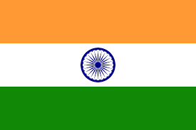
FOCUS: INDIA
WHY INDIA, WHAT ARE THE CONCERNS?
Due to the sheer massive number of cases in the country which has readily available vaccine producing pharmaceutical infrastructure.
Indian drug companies are major manufacturers of vaccines distributed worldwide, particularly those for low-income countries, supplying more than 60% of vaccines supplied to the developing world
India is one of the world's leading suppliers of drugs -- mostly generic formulations -- but depends on imports for its requirement of APIs and KSMs, particularly China, which accounted for more than 60 per cent of requirements in some therapy areas.
plant closures in China due to the coronavirus pandemic earlier in the year and the more recent border standoff with China, which underscore supply-disruption risk due to overdependence on imports.
THE RAY OF HOPE:
The government announcement, which includes production-linked incentives and financial assistance schemes aggregating to 1.3 billion dollars, will help address the two keys issues:
The higher cost of domestic production compared with imports
Funding requirement to set up the necessary infrastructure.
The production-linked incentive scheme -- which accounts for Rs 90 crore of planned outlay -- offers an incentive of up to 20 per cent of sales for fermentation-based products and up to 10 per cent for chemical synthesis-based products for the next eight to nine years.
The government has also allocated 0.4 billion dollars (about Rs 3,000 crore) under the capex assistance scheme to fund up to 90 per cent of the investment need to build common infrastructure facilities in three bulk drug parks.
Companies may not need to make large investments to participate under the incentive schemes
The government has assembled a task force to determine how best to distribute the vaccines. It is headed by Vinod Paul, a member of the National Institution for Transforming India, a government think tank, and has representatives from state and central government agencies. The government is also working with vaccine makers to speed up clinical trials and regulatory approvals.

Slide 7
POSSIBLE THIRD PARTY MANUFACTURERS:
Since the virus has the greatest number of cases since the beginning in the state of Maharashtra, it seems to be a suitable location to set up a third party manufacturing unit.
However, cases have been rising out of the southern states rapidly as well.
The world’s largest vaccine maker is the Serum Institute of India in Pune, here two factories that were producing other vaccines could be redirected to effect, and the company has capability to make 60 million to 70 million doses a month at full capacity.
Biologicals E, headquartered in Hyderabad, India
Indian Immunologicals, also in Hyderabad
Bharat Biotech, Hyderabad
Zydus Cadila in Ahmedabad
POSSIBLE API MANUFACTURERS:
Would be ideal if were located nere by to the vaccine manufacturing units, available options:
Dr Reddys, multinational pharmaceutical company located in Hyderabad, Telangana. The company has over 190 medications, 60 active pharmaceutical ingredients (APIs) for drug manufacture, diagnostic kits, critical care, and biotechnology products.
Sun Pharma, headquartered in Mumbai, Maharashtra, that manufactures and sells pharmaceutical formulations and active pharmaceutical ingredients (APIs) primarily in India and the United States.
Ranbaxy, headquarters in Gurgaon, Haryana, could be vital for North Indian supply chain.
Glenmark, Maharastra—Last year, we had spun off a separate subsidiary called Glenmark Life Sciences to specially focus on the API business.
Unichem Laboratories Unichem offers a broad portfolio of APIs across various therapeutic areas. It has three manufacturing facilities to cater to the segment.
Aurobindo Pharma Limited is a pharmaceutical manufacturing company headquartered in HITEC City, Hyderabad, India. The company manufactures generic pharmaceuticals and active pharmaceutical ingredients.
Torrent Pharma, headquartered in Ahmedabad, Gujarat.

Slide 8
Tasks Carried Out in the Hierarchy, if used in India
Union Health Ministry | Responsible for making health sector related policies and Implementing them
Chief Minister of the State State department of Health State directorate of health services | They come directly under the Union Health Ministry and are responsible for implementing the health policies in the State.
Commissioner/ Collectors | Commissioners govern over a zone of the state and has an average 5-6 District Heads (Collectors) under him.
Tehsildars Circles Talathis | There is a network of Taluka Heads (Tehsildars) and Circles + Talathis under the Tehsildar. Talathis work at the grassroot level of the country.
Head Doctors and Nurses | The head doctors of the district hospitals work under the commisioner. The rural clinic doctors report to the Circles and Talathis

Slide 9

CONTINUED.. POSSIBLE LOGISTICAL PARTNERS:
The logistics sector in India is expected to touch $215 billion by the end of 2020, predicts India Brand Equity Foundation (IBEF)
Adani Logistics Limited (ALL) is a pan India end-to-end logistics services provider – asset and service-based
Future Supply Chain Solutions Ltd: India’s largest organized third-party supply chain and logistics service provider. Offer automated and IT-enabled warehousing, distribution and other logistics solutions to a wide range of customers. Temperature-Controlled Logistics
Mahindra Logistics Ltd is one of India’s largest 3PL solutions providers in the Indian logistics company which was estimated at INR 6.40 trillion in Fiscal 2017
Aegis Logistics Ltd. was incorporated in 1956, on the Bombay Stock Exchange since 1978, highly trusted brand.
FedEx: One of the global leaders in pharma logistics.
FOCUS: USA
The US is the largest single pharmaceutical market, accounting for approximately $485 billion, or 38%, of the global pharmaceutical market of $1.205 trillion in 2018.
Possible options for Cure and Pharma
Manufacture as done in previous years since as per company data sheet provided, the company is consistently increased its profits in the past and knows the USA market requirements well.
Since as per the Indian government regulations, companies are free to export post achieving a certain minimum for the Indian market, vaccines could be exported thereby cutting high manufacturing costs in the US.
The plant in Texas could further be used to supply large amounts of vaccines to nearby Mexico, which too is highly plagued by the virus.
Hence by making use of existing supply chain and Indian excess, Cure and Pharma will be able to cater to the needs of the USA market.

Slide 10
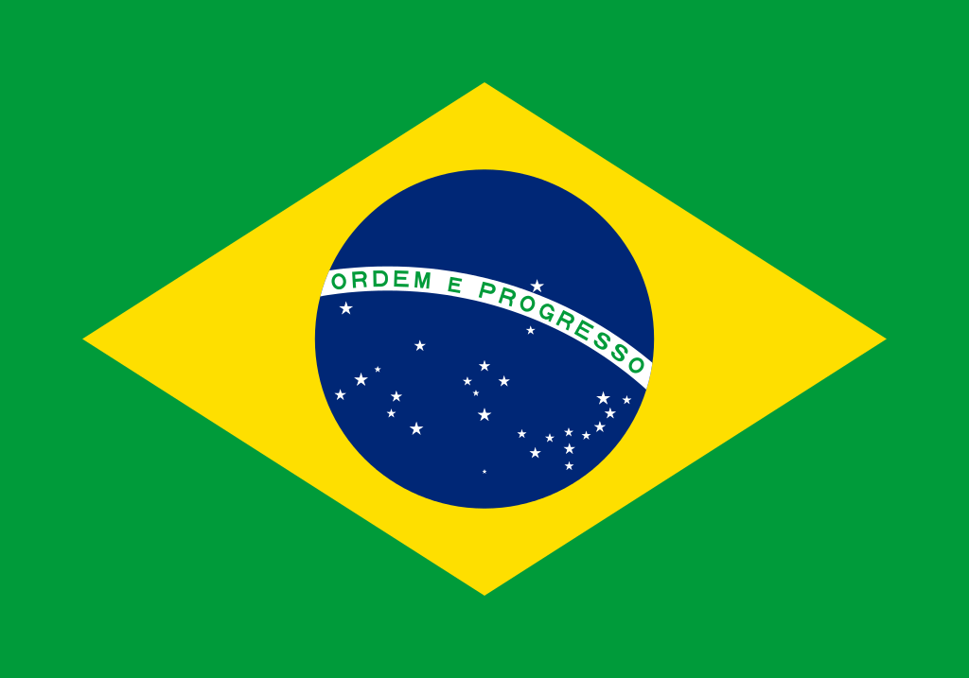
FOCUS: BRAZIL:
KEY FACTORS:
Home to about 210 million people, Brazil has the capacity to make roughly 500 million vaccines per year. Under the current coronavirus vaccine deals Brazil has stakes in, Brazilian vaccine plants would initially handle the final stages of vaccine production after importing the raw materials, and later produce them entirely.
Brazil currently has the third most cases of Covid behind USA and India.
It is a densely populated latin American country with a developing economy
Several multinational players including Pfizer and AstraZeneca are conducting trials in Brazil.
It is prime hunting ground for potential vaccines due to the sheer quantity of cases.
Highly supportive government to vaccine development and trials, regularly signing deals.
THIRD PARTY MANUFACTURERS and POSSIBLE API PRODUCERS:
Brazil has a very well developed vaccine industry, with one of the best and most complete National Immunization Programs (PNI) of any developing country (Akira, 2009;Rahim et al., 2008). There are 181 biotechnology companies in Brazil, of which 39.4% are related to health (21.1% human health; 18.3% animal health) and 19.6% are related to inputs.
Bio-Manguinhos (Rio de Janeiro) -- 100 million doses of the vaccine by the beginning of next year.
The Butantan Institute (Sao Paulo)-- with 120 million doses of the vaccine by early 2021
Ache labs, Sao Paulo
Fiocruz’s Vaccine Manufacturing Centre, Manguinhos, Brazil by the Brazilian Government.

Slide 11
REFERENCES
Hinman A. Eradication of vaccine preventable diseases. Annu Rev Public Health. 1999;20:211–29. [PubMed] [Google Scholar]
Hanjeet K, Lye MS, Sinniah M, Schnur A. Evaluation of cold chain monitoring in Kelantan, Malaysia. Bull World Health Organ. 1996;74:391–7. [PMC free article] [PubMed] [Google Scholar]
Srnivasan R. Healthcare in India—2005; issues and prospects, 2003. [cited 2006 Sep 28]. Available from: URL: http://planningcommission.nic.in/reports/sereport/ser/vision2025/health.pdf.
Patil AV, Somasundaram KV, Goyal RC. Current health scenario in rural India. Aust J Rural Health. 2002;10:129. [PubMed] [Google Scholar]
Aggarwal A, Singh AJ. Evaluation of cold chain system in rural areas of Haryana. Indian Pediatr. 1995;32:31–4. [PubMed] [Google Scholar]
The vaccine cold chain: maintaining cool links. WHO. 2002. [cited 2006 Sep 28]. Available from: URL: http://www.icn.ch/matters_colds.htm.
Bachani D, Bansal RD. Logistics management in Universal Immunization Programme. Indian J Public Health. 1990;34:179–84. [PubMed] [Google Scholar]

Slide 12
https://www.orfonline.org/research/covid19-vaccine-development-access-and-distribution-in-the-indian-context-69538/
https://covid19-projections.com/#current-us-projections
https://covid19-projections.com/#rest-of-world-summary
https://legacy.trade.gov/topmarkets/pdf/Pharmaceuticals_Top_Markets_Reports.pdf
https://www.nature.com/articles/d41586-020-02507-x
https://health.economictimes.indiatimes.com/news/diagnostics/india-can-supply-potential-covid-19-vaccines-to-the-world/76367322
https://www.livemint.com/companies/people/-covid-shows-drugmakers-need-to-collaborate-in-r-d-11597106165921.html
https://health.economictimes.indiatimes.com/news/pharma/need-to-boost-local-api-production-for-india-to-become-self-reliant-in-coming-years-unichem/77445715
https://health.economictimes.indiatimes.com/news/pharma/indias-incentives-for-domestic-api-production-could-cut-supply-risk-fitch/77459098
https://www.sciencedirect.com/science/article/pii/S0264410X20307957

Slide 13
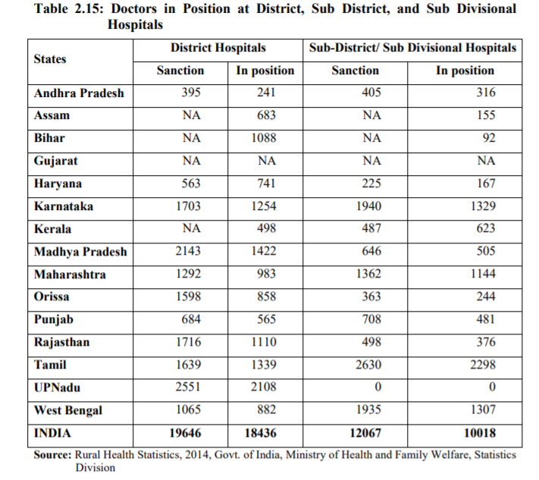
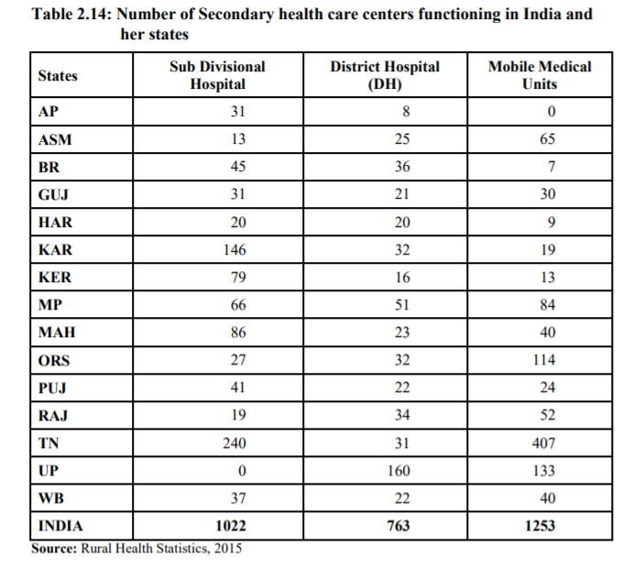

Slide 14
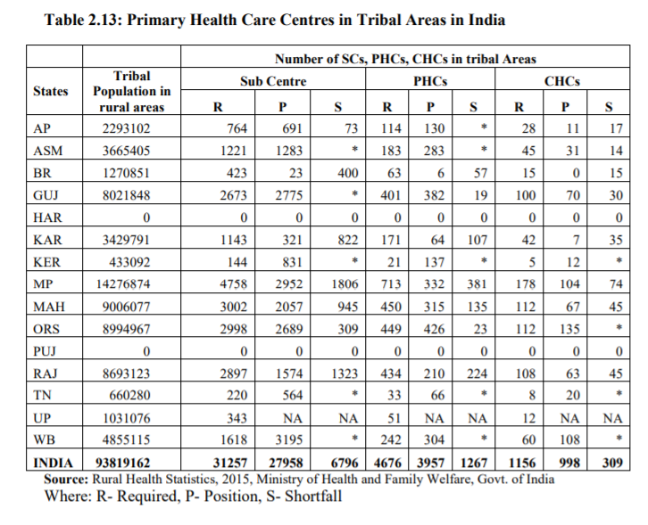
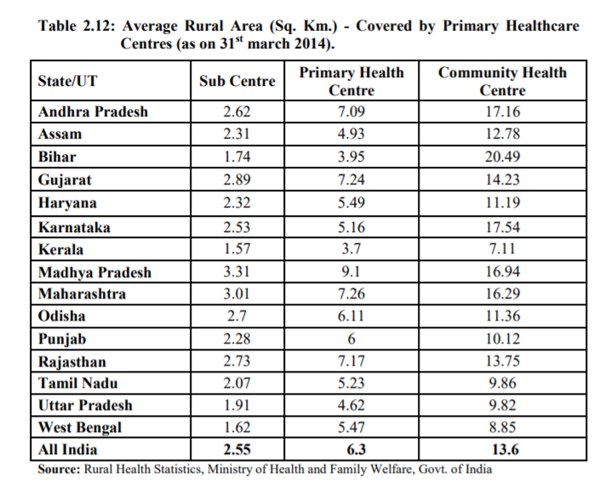

Slide 15
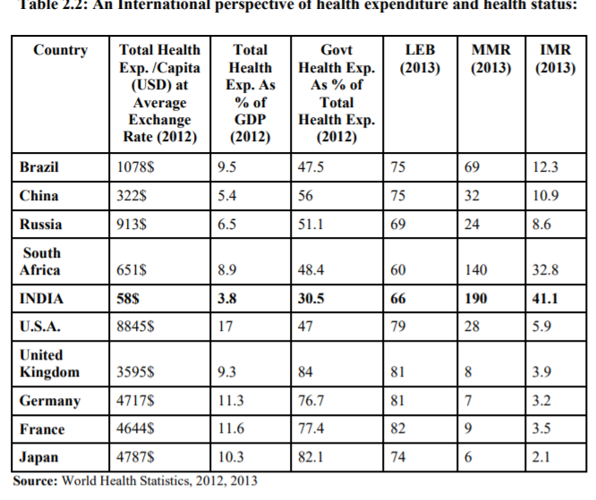
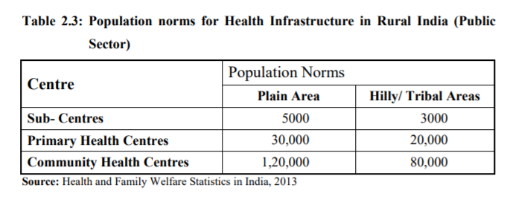

Slide 16
Thankyou!

